Slide 1
A Seminar on AUTOMATIC TIMETABLE GENERATION
Team Details
G. SAI CHARAN REDDY (20EG105114)
G. SHIRISHA (20EG105115)
N. SAI PRATHIBHA (20EG105135)
P. NITISH GOUD (20EG105137)
Project Supervisor
Name: Dr. G. Prabhakar Raju
Designation: Assistant Professor

Slide 2
Introduction
The Automatic Timetable Generation project utilizes a genetic algorithm to automatically create optimized timetables for educational institutions. Users input information like the number of courses, classrooms, teachers, and available timeslots. The genetic algorithm generates a population of schedules, evaluates their fitness based on constraints and objectives, and iteratively refines solutions through selection, crossover, and mutation. The goal is to save time and effort for institutions, enhance timetable quality by considering multiple factors, and leverage genetic algorithms' ability to handle complex constraints in a large search space. The project aims to provide an effective and efficient solution for automated timetable generation.

Slide 3
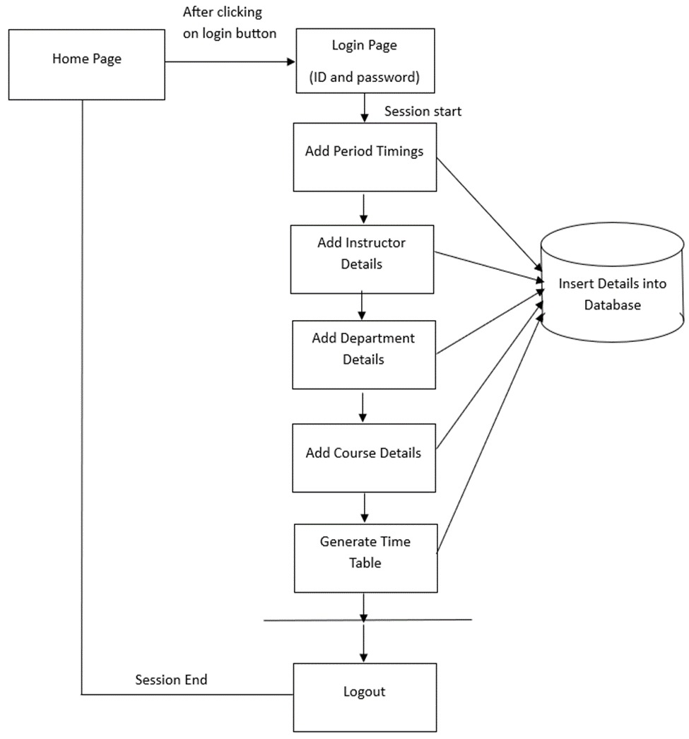
Concept Tree

Slide 4
Literature
Author(s) | Strategies | Advantages | Disadvantages
Esraa A. Abdelhalim and Ghada A.El Khayat | Population Generation, Fitness Function, Selection, Crossover, Mutation, Elitism, Termination. | 1.Maximizes resource utilization for efficient scheduling. 2.Effectively manages various timetabling constraints. | 1.High computational requirements, especially for large datasets. 2.Effectiveness depends on tuning crossover and mutation rates
Meysam Shahvali Kohshori and Mohammad Saniee Abadeh | Problem Encoding, Initial Population, Fitness Function, Crossover, Mutation, HybridFeatures, Termination. | 1.Hybrid features accelerate convergence and enhance solution quality. 2.Diverse crossover and mutation operators explore varied solution spaces | 1.GAs can be computationally expensive, especially for complex constraints. 2.Effectiveness depends on tuning parameters, which can be time-consuming.

Slide 5
Literature(cont..) selected strategy:
Author(s) | Method | Advantages | Disadvantages
Mrunmayee V. Rane; Vikram M. Apte; Vishakha N. Nerkar; Mani Roja Edinburgh; K.Y. Rajput | Input Module, Operational Module, Display Module. | 1.System ensures efficient resource allocation with more optimized and accurate timetables. 2. Saves administrators significant time, allowing focus on more productive tasks. | 1.Algorithm complexity (cube root of n) may challenge computational resources for larger datasets or real-time adjustments. 2.User unfamiliarity with the system may lead to a learning curve, potentially causing initial resistance or errors during the transition.

Slide 6
Problem Statement
Time Table Scheduling is an NP-hard problem and hence polynomial time verifiable using genetic algorithms. It a typical scheduling problem that appears to be a tedious job in every academic institute once or twice a year. In earlier days, time table scheduling was done manually with a single person or some group involved in task of scheduling it manually, which takes a lot of effort and time. Planning timetables is one of the most complex and error-prone applications.

Slide 7
Problem Illustration
The program takes input of number of periods and their time slots along with the break slot, working days, teacher details with the subjects they teach, batches with the subjects allocated with them, different time slots for each subject to each branch that sums up to the total available hours, aiming to meet user-defined constraints like resource availability, conflict avoidance, and fairness. Through genetic algorithm operations, it refines solutions iteratively until a satisfactory timetable is produced, providing an efficient and automated solution for complex scheduling challenges

Slide 8
Proposed Method
The proposed system for Automatic timetable Generation utilizes genetic algorithms to efficiently generate optimal timetables for educational institutions. It features a user-friendly interface for inputting constraints such as teacher availability, course prerequisites, and classroom availability. The genetic algorithm creates a population of possible timetables, employing crossover and mutation operations to produce new generations. A fitness function evaluates each timetable based on constraints and objectives, selecting the fittest for the next generation. Users can visualize, evaluate, and refine schedules, adjusting limits as needed, and compare multiple schedules to choose the best fit. The system handles complex constraints, offers flexibility, and is designed for ease of use, saving time and effort for educational institutions. Additionally, it accommodates staff-student interactions, allowing uploads of requests, notes, presentations, and e-books while considering changes and restrictions for future schedules.

Slide 9
Proposed Method Illustration
1)First of all an initial generation of chromosomes is created randomly and their fitness value is analysed.
New Generations are created after this. For each generation, it performs following basic operations:
First of all preserve few fittest chromosomes from the previous generation as it is. This is called Elitism and is necessary to preserve desired characteristics in the coming generations .
Randomly select a pair of chromosomes from the previous generation. Roulette wheel selection method has been used here in this project.
Perform crossover depending on the crossover rate which is pretty high usually. Here single point crossover has been used.
Perform mutation on the more fit chromosome so obtained depending on the mutation rate which is kept pretty small usually.
2)Now analyze the fitness of the new generation of chromosomes and order them according to fitness values.
3)Repeat creating new generations unless chromosomes of desired fitness value i.e. fitness=1, are obtained.

Slide 10
Parameter
The parameter formulas mentioned in the provided text can be derived from the explanation of the Genetic Algorithm (GA) process for Time Table Scheduling. Here are some of the key parameters mentioned:
1. Initialization:
- Population Size (N):Number of chromosomes in the initial population.
2. Genetic Operations:
a. Elitism:
- Elitism Ratio (ER): Percentage of fittest chromosomes preserved from the previous generation.
b. Selection:
- Selection Probability (SP): Probability of selecting a chromosome based on its fitness during the Roulette Wheel Selection.

Slide 11
Parameter
c. Crossover:
- Crossover Rate (CR): Probability of crossover occurring between two selected chromosomes.
- Crossover Point (CP): Randomly chosen point for the Single Point Crossover, ensuring it doesn't intersect student group timetables.
d. Mutation:
- Mutation Rate (MR): Probability of mutation occurring on the more fit chromosome.
- Swap Mutation: Specific technique involving the exchange of two portions of the chromosome.
3. Sorting and Selection:
- No specific parameters , but it involves ordering chromosomes based on their fitness.

Slide 12
Experiment Environment
1.Development Language and Framework:
- Java 8
- Struts-2 framework
- Java Server Pages (JSP)
- Servlets
2. Database:
- MySQL database
3. Frontend Design:
- HTML 5
- Cascading Style Sheets (CSS)
- JavaScript
- Bootstrap
- Ajax
4. Web Server:
- Apache Tomcat-9 (locally hosted during development)
5.Experimentation Data:
- Sample input provided in the form for testing purposes during development.

Slide 13
Project status
S.No | Functionality | Status (Completed /in-progress/Not started)
1 | Research and analysis | In-progress
2 | Implementing Generic Algorithm | In-progress
3 | Back-end | In-progress
4 | Front-end | Not started

Slide 14
References
[1] A Utilization-based Genetic Algorithm for Solving the University Timetabling Problem (UGA) by Esraa A. Abdelhalim, Ghada A. El Khayat, Information Systems and Computers Department, Faculty of Commerce, Alexandria University, Alexandria, Egypt, Received 6 September 2014, Revised 10 February 2016, Accepted 20 February 2016, Version of Record 25 June 2016.
[2] Hybrid Genetic Algorithms for University Course Timetabling, March 2012,International Journal of Computer Science Issues 9(2) by Meysam Shahvali Kohshori and Mohammad Saniee Abadeh.
[3] Automatic Timetabling System for University Course” by Mrunmayee V. Rane, Vikram M. Apte, Vishakha N. Nerkar, Mani Roja Edinburgh, K.Y. Rajput published in 2021 International Conference on Emerging Smart Computing and Informatics (ESCI) AISSMS Institute of Information Technology, Pune, India.

Slide 15
Thank you

Slide 16
Project seminar–I Evaluation
S.No | Rubrics | Marks
1 | Concept Introduction | 4
2 | Literature and Parameter | 5
3 | Problem and Problem Illustration | 8
4 | Proposed Method and Illustration | 8
Total |  | 25

